Slide 1
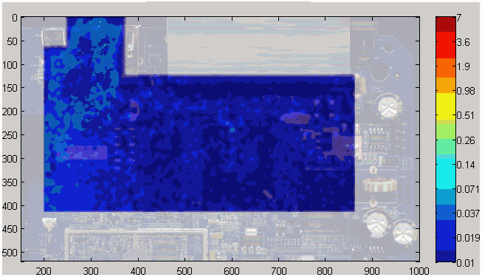
Example: Current Visualization Scanning
USB strike causing Ethernet soft error…
ESD pulse is injected into USB port
(4) Some energy coupled into nearby nodes (Ethernet port) causing upset
(2) ESD Clamp shunts majority of pulse to ground plane
(H-Field Response)
(3) Residual Current shunted by clamps inside ASIC

